Slide 1
k-Nearest Neighbor

Slide 2
k-Nearest Neighbor
In k-NN, given a labeled training set
And, given a point that we want to classify
That is, a point not in training set
We’ll let training data “vote”
Who gets to vote?
That is, which data points in the training set get to vote?
And how to count (weight) the votes?

Slide 3
k-NN
Which data points get to vote?
If it’s a “national” election, and majority rules, the most numerous class always wins
That’s not very informative, so no universal suffrage in k-NN
But what about “local” elections?
Only the training data nearby gets to vote
This might be more useful…

Slide 4
k-Nearest Neighbors
Given a set of labeled training data…
And given a point to classify
Classify based on k nearest neighbors
Where “neighbors” are in training set
Value of k is specified in advance
The simplest ML method known to man
And, not to mention, woman
Simple wrt training, since no training…
Notes:
No training required!

Slide 5
k-NN Example
Red circles and blue squares are training data
Note that we assume labeled training data
Suppose we want to classify green diamond…
And we want to keep it as simple as possible

Slide 6
1-NN Example
1-NN
Or more simply, nearest neighbor
Since blue square b is nearest…
Classify green diamond x as “blue”

Slide 7
3-NN Example
3-nearest neighbors
Classify based on 3 nearest points
3 nearest to x are…
2 red points, r₁, r₂, and 1 blue point, b
Using 3-NN, we classify x as “red”

Slide 8
k-NN Variations
We could also weight by distance
E.g., use 1/d(x,b) for each blue b nearest neighbor, and 1/d(x,r) for red r
Sum these by color, biggest sum wins…
We might weight by class frequency
Suppose training set has B blue and R red, with R > B
Weight each red as 1, each blue as R/B (total # of red over total # of blue in the dataset)
Might also consider a fixed radius
Notes:
In the case of a fixed radius, we automatically use more data points in regions where the training data is more dense, and less where it is less dense. Of course, this could be combined with a minimum k, just to be sure the decision is not made based on some minimum number of data points.

Slide 9
k-NN Weighted by Distance
Suppose use 1/d(x,y)
For this weight, 3-NN classifies x as “blue”…
Assuming
1/d(x,b) > 1/d(x,r₁) + 1/d(x,r₂)

Slide 10
k-NN Weighted by Frequency
Suppose we weight by frequency
Then each red is 1
And each blue is 2.5 (10 reds / 4 blues)
In this case, 3-NN classifies x as blue
Blue “score” is 2.5
Red “score” is 2.0

Slide 11
k-NN Advantages
k-NN is a “lazy learning” algorithm
No training (none, nada, zippo) required
All computation deferred to scoring phase
In limit, k-NN tends to (near) optimal…
…as size of training set grows
Works for multi-classification
I.e., not restricted to binary classification
Notes:
But, the optimal k also grows
Optimal in sense of “Bayes error rate”

Slide 12
k-NN Disadvantages
Scoring not entirely straightforward
In naïve approach, distances to all points needed for each score computation
Can use fast neighbor search algorithms (e.g., Knuth’s “post office problem”)…
…but then lose some of the simplicity
Very sensitive to local structure
Random variations in local structure of training set can have undesirable impact

Slide 13
Bottom Line
k-NN is as simple as it gets
And simple is good, provided that it works
Training is non-existent
Scoring is somewhat more involved
But still conceptually simple
Lots of variations on the theme
Can be combined with other techniques
E.g., k-NN used in scoring phase of PCA

Slide 14
Random Forest

Slide 15

Random Forest
Do you remember bagging?
Bagging is used when generating a random forest, where each individual scoring function is based on a decision tree structure

Slide 16
Random Forest
Random forest (RF) is generalization of a decision tree
Decision tree is really, really simple
Very intuitive and can be useful
So, why do we need to generalize?
Decision trees tend to overfit data
Random forest reduces overfitting
But lose some of the intuitive simplicity

Slide 17
Decision Trees
A decision tree is just what it says…
Tree that is used to make decisions
Kind of like a flow chart
Each node is a test condition
Each branch is outcome of test represented by corresponding node
Leaf nodes contain the final decision
Simple, simple, simple, …

Slide 18
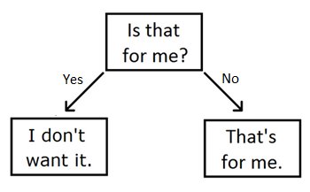
Cat’s Decision Tree
This one-level decision tree is also called a “decision stump”

Slide 19
Decision Trees
Advantages?
Can be constructed with little/no data and can be tested if/when data available
Easy to understand, easy to use, easy to combine with other learning methods, …
Disadvantages?
Constructing optimal tree is NP complete
Overfitting, complex trees, how to prune?
Some concepts not easy to fit to trees
Notes:
For example, XOR is not easy to express in the form of a decision tree.

Slide 20
Decision Tree Example
Suppose that we have labeled training data for malware and benign samples
Features: file size and entropy
We observe that malware tends to be smaller in size with higher entropy
As compared to benign samples
Easy to construct decision tree(s)
Next slides…

Slide 21
Decision Tree Example
Large vs small, high vs low thresholdsbased on data

Slide 22
Decision Tree Example
Other order works too…
Which is better?
Notes:
Information gain…

Slide 23
Decision Tree Decisions
Generating optimal decision tree can be hard, so what to do?
Approximate (how?)
We’ll use a simple greedy approach
Choose feature that provides most information gain and split data
From remaining features, select the one that provides most information gain
Continue until gain is below a threshold
Notes:
The Gini index is another popular measure that can be used

Slide 24
Decision Tree
Why greedy?
Want to use best classifiers first, so smaller trees have most the useful info
Want most info gain closer to root (good when we want to prune the tree)
Fast and efficient to construct, since no backtracking or other complex algorithm
Make use of most relevant information in training data

Slide 25
Information Gain
“Gain” can be measured using entropy
Recall, entropy measures uncertainty
Information gain for feature A ?
Entropy reduction if data is split on A
We want to maximize information gain
Compute gain for each remaining feature
Split on feature with biggest info gain
Repeat until gain is below some threshold

Slide 26
Information Gain
Let P(x_{i}) be probability of outcome x_{i}
Then entropy of X = (x₁,x₂,...,x_{n}) is:
“How many yes/no questions we need to ask to guess the outcome?”
“Binary” question
The ‘–’ gives a positive output from values in [0-1]

Slide 27
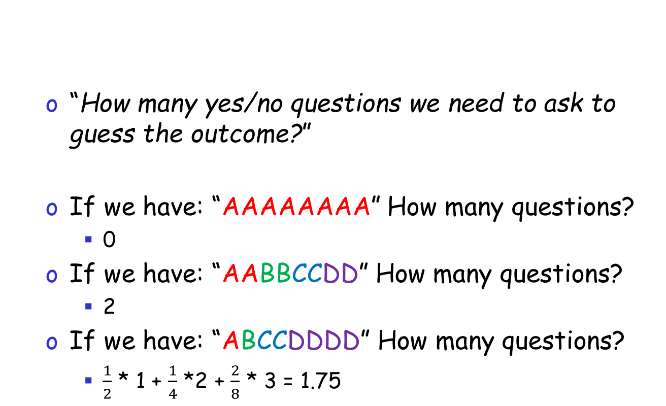
Information Gain
“How many yes/no questions we need to ask to guess the outcome?”
If we have: “AAAAAAAA” How many questions?
0
If we have: “AABBCCDD” How many questions?
2
If we have: “ABCCDDDD” How many questions?
$\frac{1}{2}$ * 1 + $\frac{1}{4}$ *2 + $\frac{2}{8}$ * 3 = 1.75
Number of questions times the probability

Slide 28
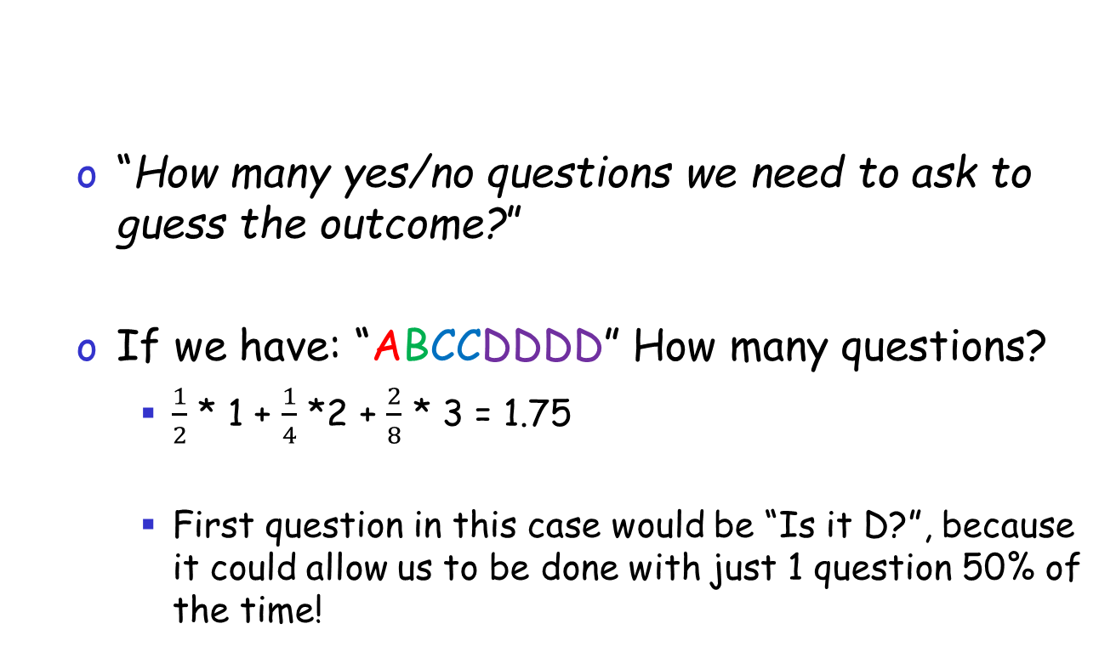
Information Gain
“How many yes/no questions we need to ask to guess the outcome?”
If we have: “ABCCDDDD” How many questions?
$\frac{1}{2}$ * 1 + $\frac{1}{4}$ *2 + $\frac{2}{8}$ * 3 = 1.75
First question in this case would be “Is it D?”, because it could allow us to be done with just 1 question 50% of the time!

Slide 29
Information Gain
Let P(x_{i}) be probability of outcome x_{i}
Then entropy of X = (x₁,x₂,...,x_{n}) is:
Suppose that we have 10 malware and 10 benign samples
Measure file size, entropy, and number of distinct opcodes for each

Slide 30
Training Data
Notation
S(X) is size
H(X) entropy
D(X) opcodes
How to set thresholds?
Midway between averages…
Notes:
Size is in (say) KB, and entropy is in bits. Note that 115 is threshold for S(X), with less than 115 indicating malware, while greater than 115 indicating benign. Similarly, 5.5 is the threshold for entropy, and 27.5 the threshold for number of distinct opcodes.

Slide 31
Notation
S(X) is size
H(X) entropy
D(X) opcodes
For example, for Size ->
Average is 110 (MW) and 120 (BN)
We can set the threshold to 115
Note that 115 is in between 110 and 120
Malware < 115
Benign > 115
Notes:
Size is in (say) KB, and entropy is in bits. Note that 115 is threshold for S(X), with less than 115 indicating malware, while greater than 115 indicating benign. Similarly, 5.5 is the threshold for entropy, and 27.5 the threshold for number of distinct opcodes.

Slide 32
Notation
S(X) is size
H(X) entropy
D(X) opcodes
Now we have two sets
Benign and malware samples based on size
T_{m} = {X₃,X₅,X₆,X₇,X₉,X₁₀,Y₄,Y₅,Y₈,Y₉} classified as malware
T_{b} = {X₁,X₂,X₄,X₈,Y₁,Y₂,Y₃,Y₆,Y₇,Y₁₀} classified as benign
Compute entropy of T_{m} and T_{b}
Notes:
Size is in (say) KB, and entropy is in bits. Note that 115 is threshold for S(X), with less than 115 indicating malware, while greater than 115 indicating benign. Similarly, 5.5 is the threshold for entropy, and 27.5 the threshold for number of distinct opcodes.

Slide 33
Formula:
T_{m} = {X₃,X₅,X₆,X₇,X₉,X₁₀,Y₄,Y₅,Y₈,Y₉} classified as malware
T_{b} = {X₁,X₂,X₄,X₈,Y₁,Y₂,Y₃,Y₆,Y₇,Y₁₀} classified as benign
Compute entropy of T_{m} and T_{b}
Notes:
This is nothing more than #X /#elements in T (simplified)
.97 is not very good, too much uncertainty!

Slide 34
Information Gain
Entropy computed as
Information gain ?
Entropy of parent node minus average weighted entropy of child nodes
For “size” feature, information gain is
G_{S} = 1.0 – 0.9710 = 0.0290
Notes:
Completely uncertain when we start, so 1.0.

Slide 35
Information Gain
Similarly, we compute
G_{S} = 0.0290, G_{H} = 0.1952, G_{D} = 0.5310
Conclusion?
Want to make first split based on number of distinct opcodes, D(X)
Then need to recalculate information gain for remaining features
To decide which to select for 2nd level

Slide 36
Bagging
Decision trees good, maybe too good…
Tend to overfit data
Overfitting is bad in ML (why?)
What to do?
Bagging (bootstrap aggregation)
Multiple decision trees on subsets of data
Then combine results (e.g. majority vote)
Easy way to reduce overfitting
Notes:
Bagging can be effective at reducing the variance.

Slide 37
Bagging Example
Suppose we have sample U to classify
We measure S(U) = 116 and H(U) = 7
Note that based on training data
5.5 is threshold for entropy H(X)
115 is threshold for size S(X)
Suppose we classify using tree that splits first on entropy, then size
Ignoring opcode feature in this example

Slide 38
Bagging Example
Then U is classified as benign
But this is suspect…
Why?
Suppose instead, use bagging
As on next slide…
H(U) = 7 > 5.5
S(U) = 116 > 115

Slide 39
Bagging
Suppose we select subsets
Then subset A is:

Slide 40
For subset A …
Threshold for S(X) is 117 and H(X) is 5.9
And U classified as malware!!!
H(U) = 7 > 5.9
S(U) = 116 < 117

Slide 41
Bagging
Easy to show that U is classified as…
Malware based on subset A
Benign based on subset B
Malware based on subset C
So, by majority vote, U is malware
Recall, U was benign based on all data
But that classification looked suspect
Bagging better generalizes the data
At least in this case…

Slide 42
Random Forest
Random forest uses bagging in 2 ways
Bagging of data (as on previous slide) …
… and bagging of features
How to bag features?
Select subset of features and ordering
RF training algorithm use heuristic to do smart bagging

Slide 43
Random Forest and k-NN
Interesting connection between RF and k-NN algorithms
As usual, let (X_{i},z_{i}), i=1,2,…,n be training set, and each z_{i} is -1 or +1
Then define weight function
And define

Slide 44
Decision Tree and k-NN
For a given decision tree, define
And
So what?
Notes:
For a single decision tree, get either +1 or -1, but for a random forest we obtain a sum that is either positive or negative depending on the classification (assuming majority vote), similar to k-NN case.

Slide 45
Decision Tree and k-NN
Then k-NN is equivalent to…
Classify X as type +1 if score_{k}(X) > 0
And type -1 otherwise
And decision tree (DT) is same as…
Classify X as type +1 if score_{t}(X) > 0
And type -1 otherwise
DT and k-NN are neighborhood-based
But different neighborhood structure

Slide 46
Random Forest and k-NN
Random forest is collection of DTs
So, same approach as on previous slides applies to RF
Implies RF also neighborhood-based
Like decision tree…
...but neighborhood structure is significantly more complex
Somewhat surprising connection...

Slide 47
Bottom Line
Decision tree is a simple concept
Bagging data generalizes decision tree
Less prone to overfit
Random forest further generalizes concept of bagging
Bagging for both data and features
Often, RF gives very good results
Perhaps more surprisingly, so does k-NN

